Slide 1
New set of figures as of jan 2025

Slide 2
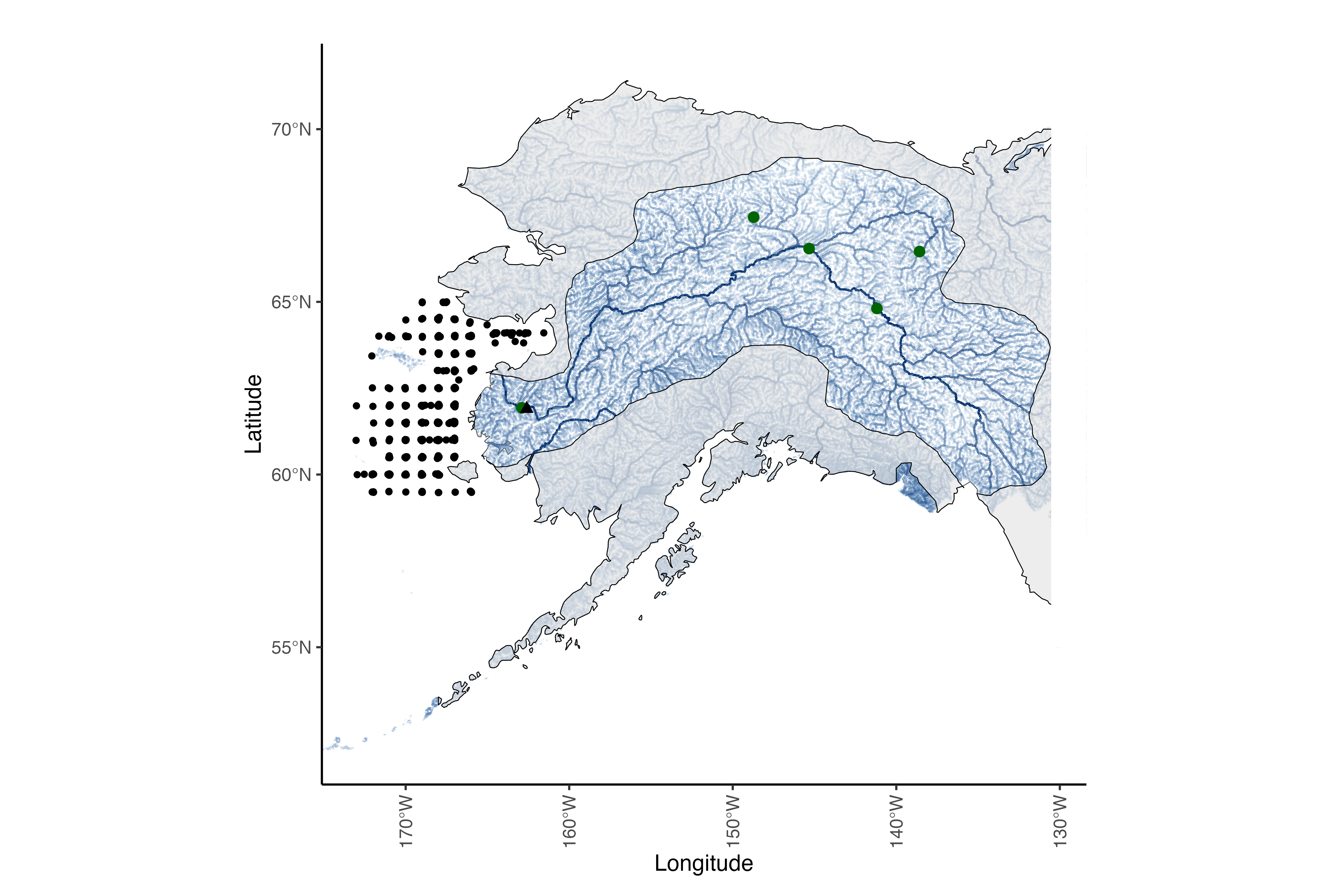
Updated fig 1 – now it is just map.
Notes:
Figure 1: Map of the Yukon River watershed, which includes Alaska, USA, and western Canada. The mask is highlighting the Yukon River watershed and associated tributaries, the mainstem of the Yukon River is the most prominent dark blue line and the green dots represent ADFG escapement project locations that were used as data in the Fall chum salmon run reconstruction. The black triangle represents Pilot Station, AK, the source of the USGS flow measurement station for the Yukon mainstem. The black gridded points represent survey stations for the NBS survey that collected information for the juvenile index and the stomach fullness index used in the IPM.
---- try to add box for region temperatures are extracted from

Slide 3
Updated fig 2 – now just conceptual figure.
Notes:
Figure 2: Covariates used to estimate chum salmon population productivity for two life stages. Data sources listed below the covariate and more covariate details are listed in Table 2.

Slide 4
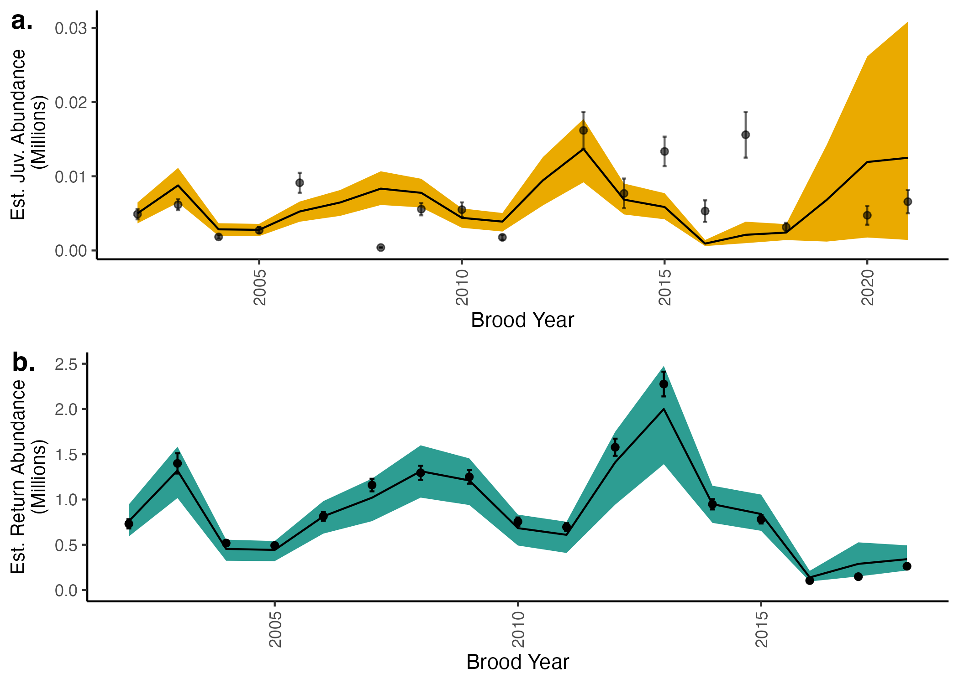
Notes:
Figure 3: Time series of indices used in the model likelihood inputs and model fits.
Points represent juvenile (a) and returning fish (b) indices used in the model likelihood while the lines represent the mean from estimated posterior distributions. Colored bands represent 95% credible intervals. The x axis represents the brood year, or the year when fish are in the egg stage. The NBS survey used to estimate the juvenile index did not occur in 2020 due to the global pandemic, so there is no juvenile index for brood year 2019.

Slide 5
Perhaps add an age comp predicted observed plot! Like currys figure 2.

Slide 6
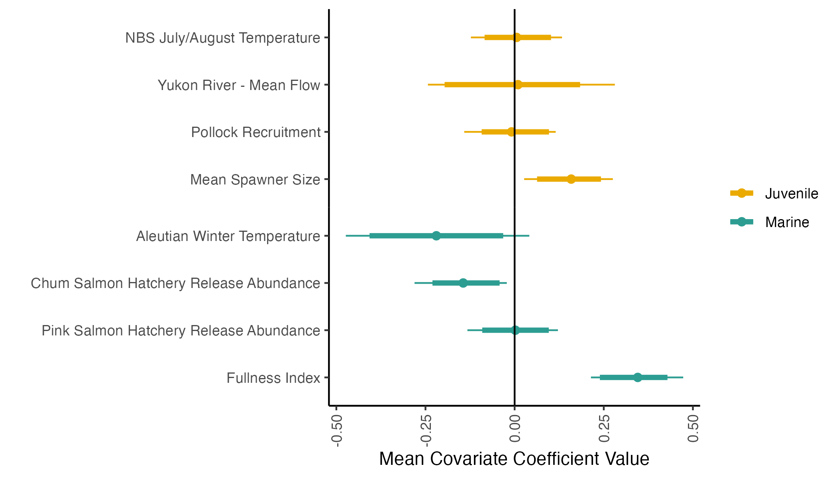
Notes:
Figure 4: Mean estimates of covariate coefficients. Colors represent the life-stage where survival is estimated, informed by the respective covariate. Points represent mean estimates, thick lines represent 89% credible intervals and thin lines represent 95% credible intervals.

Slide 7
Supplementary Figures

Slide 8
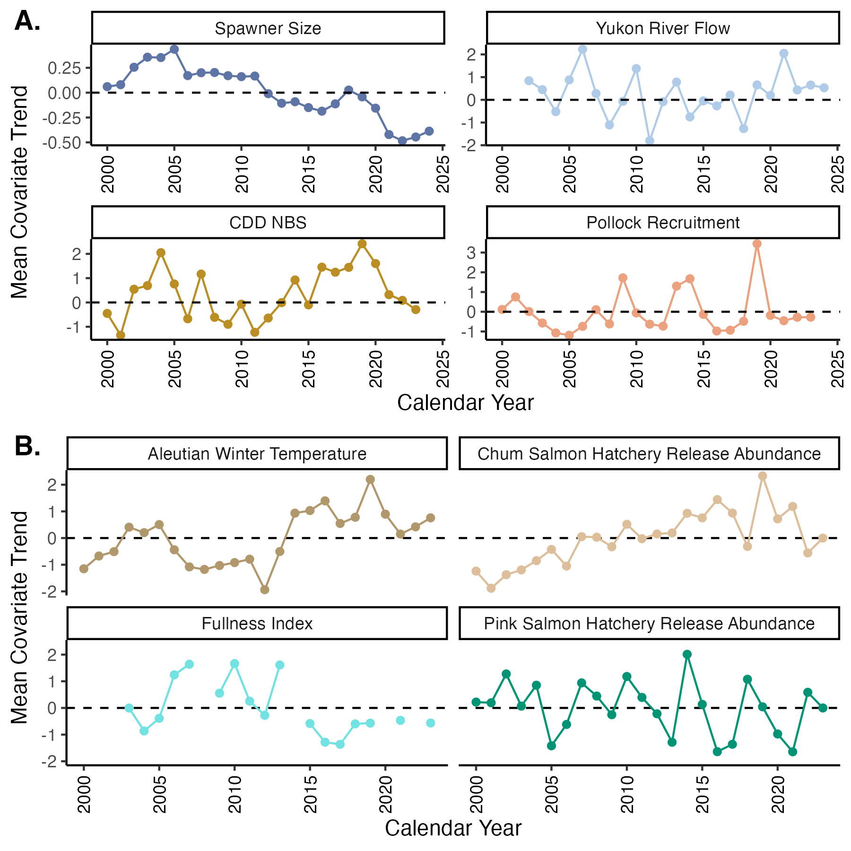
Notes:
Figure S1:
Mean-scaled covariate trends used in the IPM for the a) juvenile (egg to first summer at sea) and b) marine (first summer at sea to end of first winter at sea) stages.

Slide 9
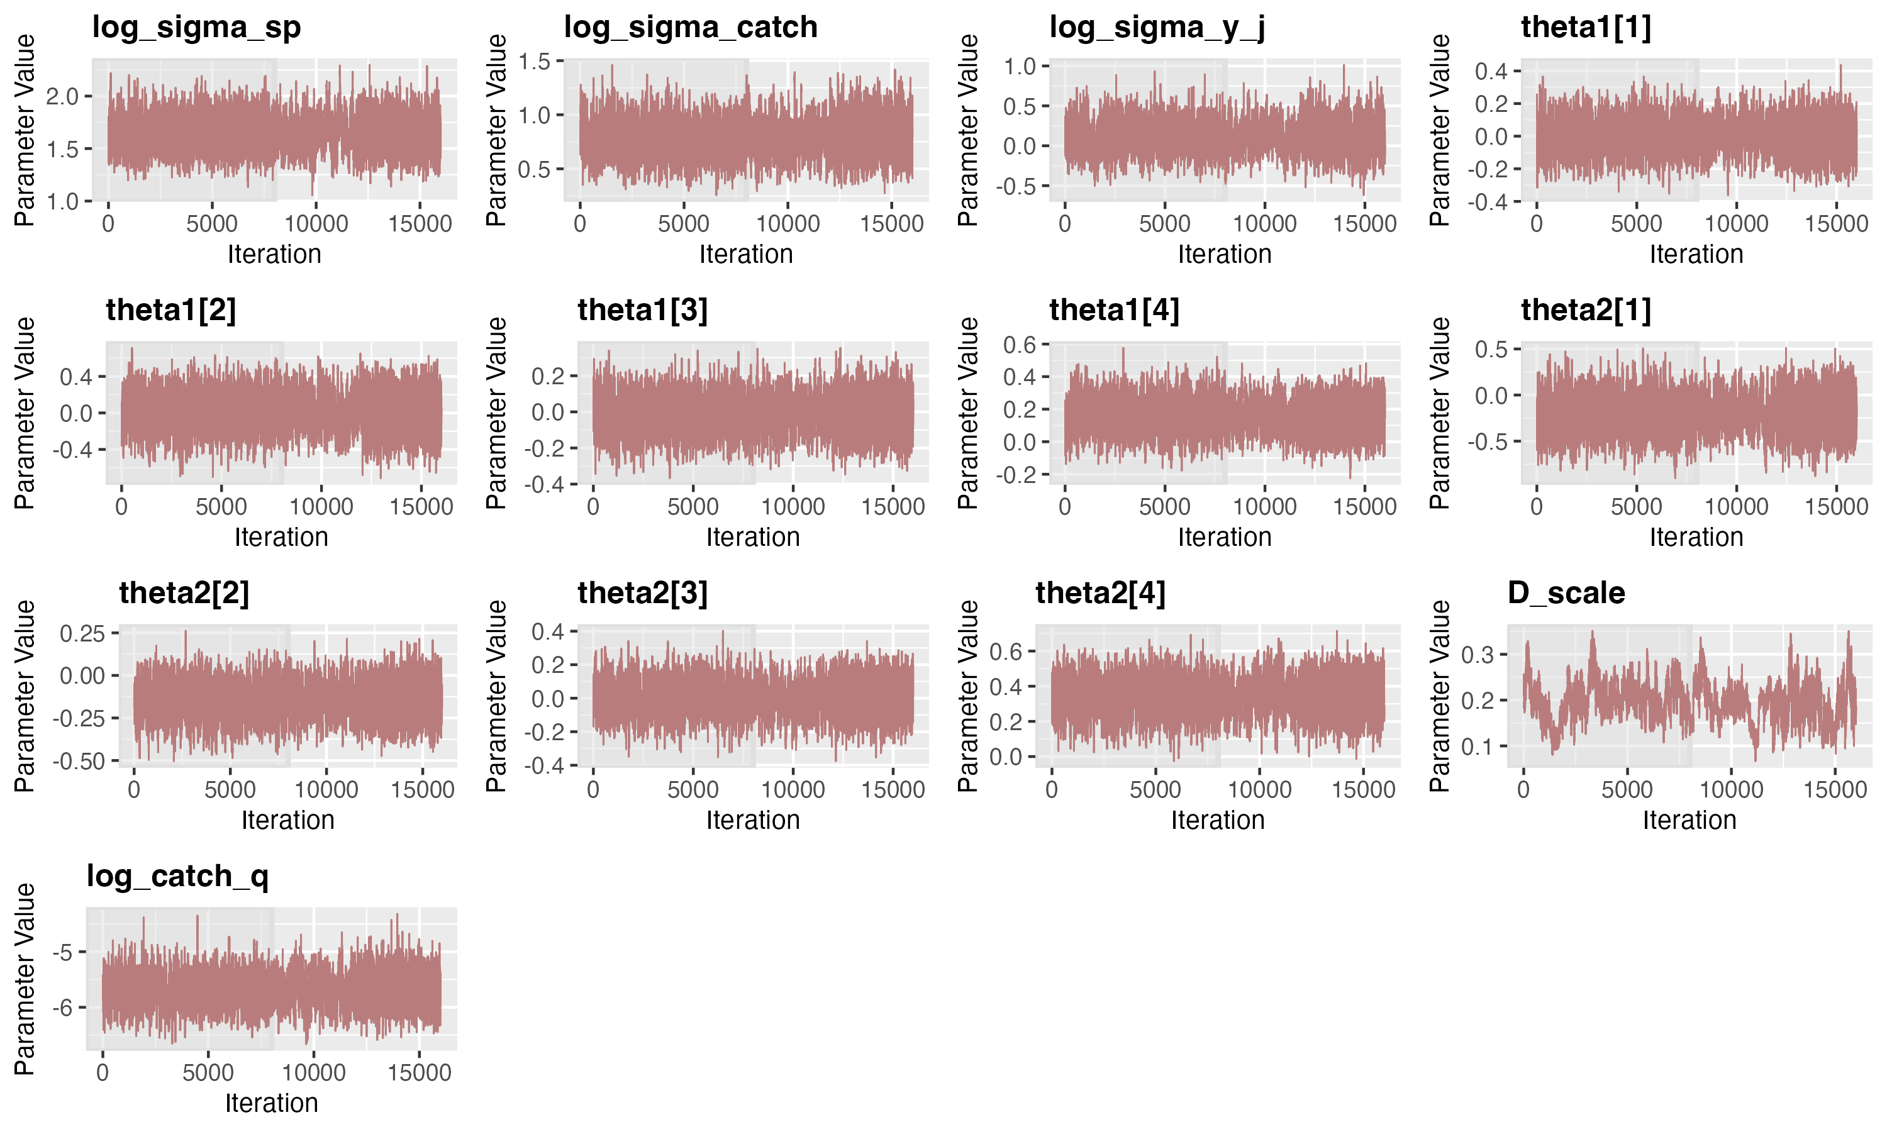
Notes:
Figure S2 – Trace plots used to identify model convergence for each for parameters. Four chains were run per model, dark shading represents burn-in iterations.

Slide 10
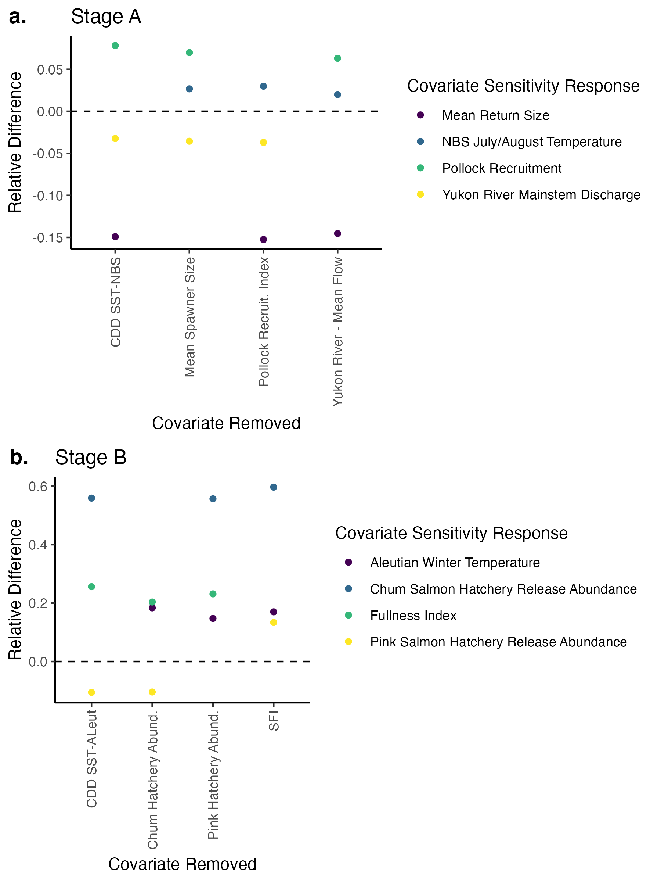
Notes:
Figure S3:
Results from covariate sensitivity testing. We calculated percent relative difference in covariate coefficients from the full model compared to a reduced model where one covariate removed at a time (covariate removed identified on x axis).

Slide 11
Older figures

Slide 12
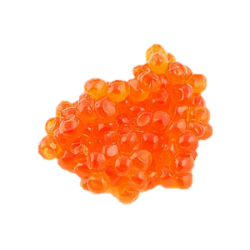
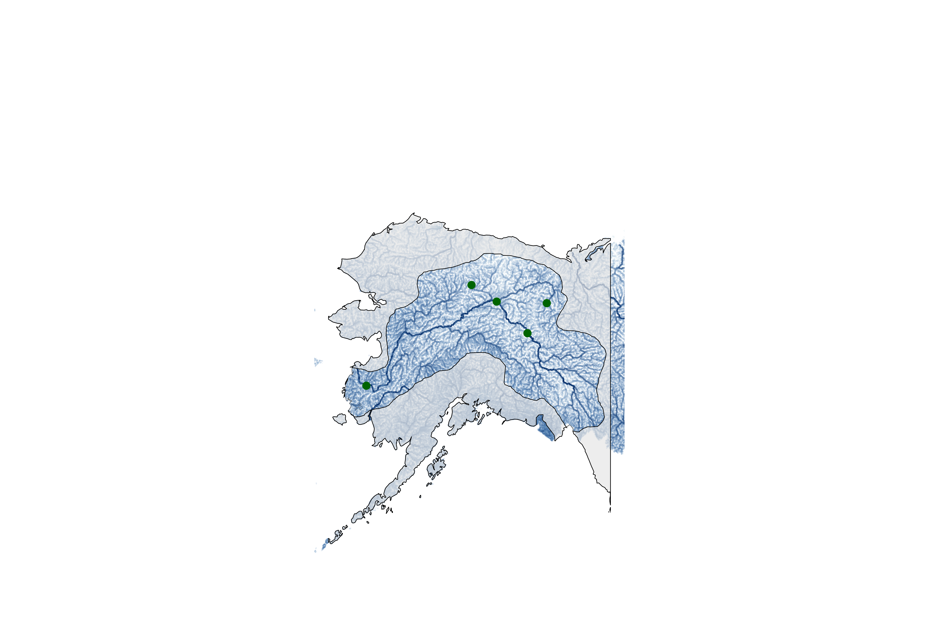
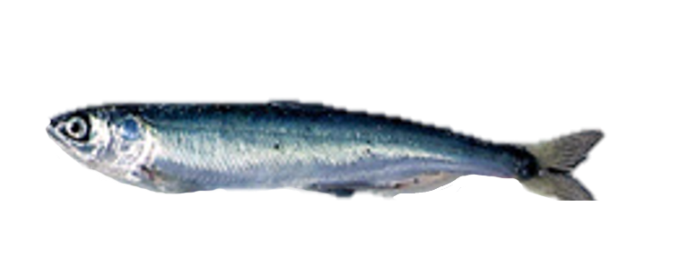
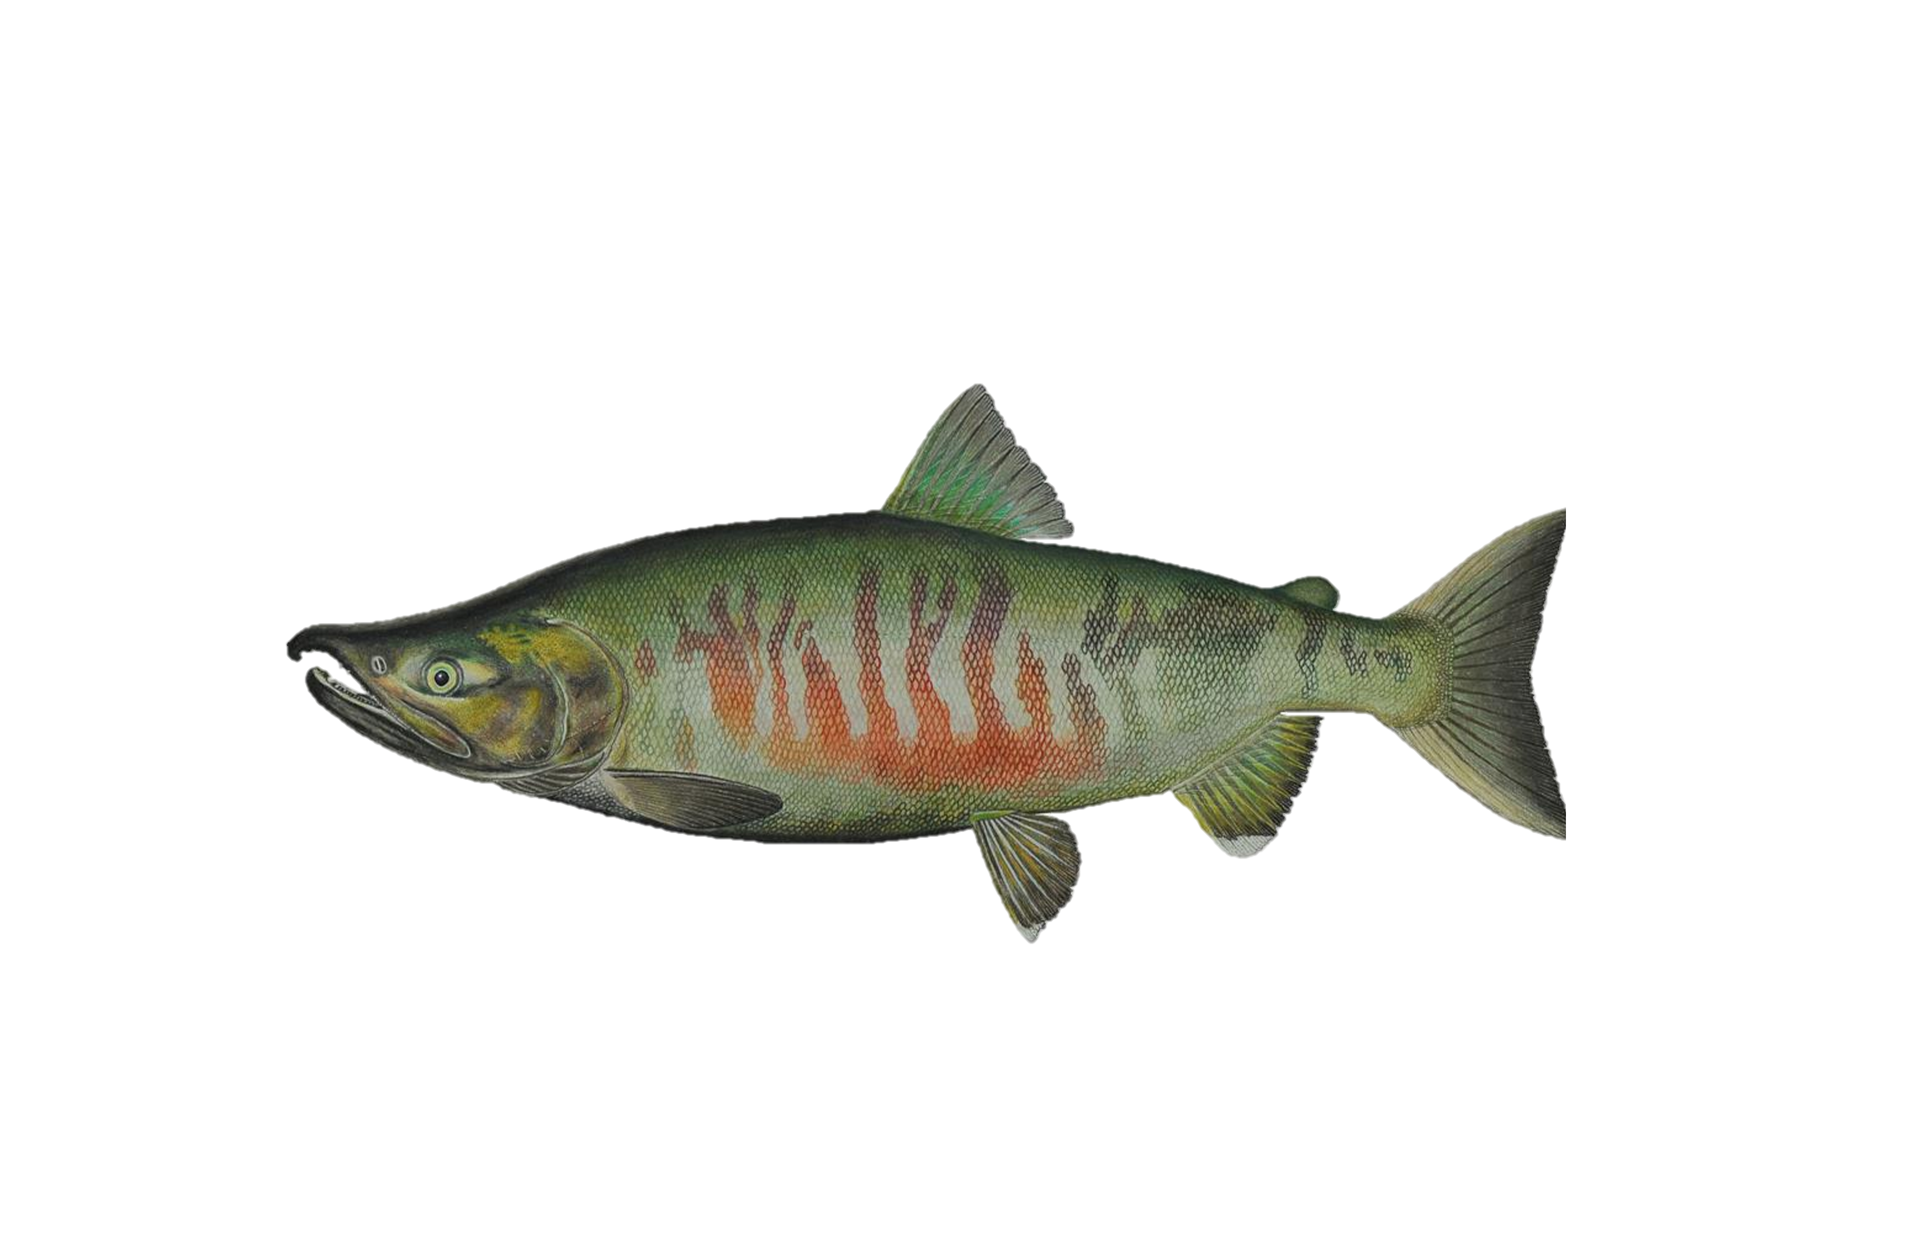
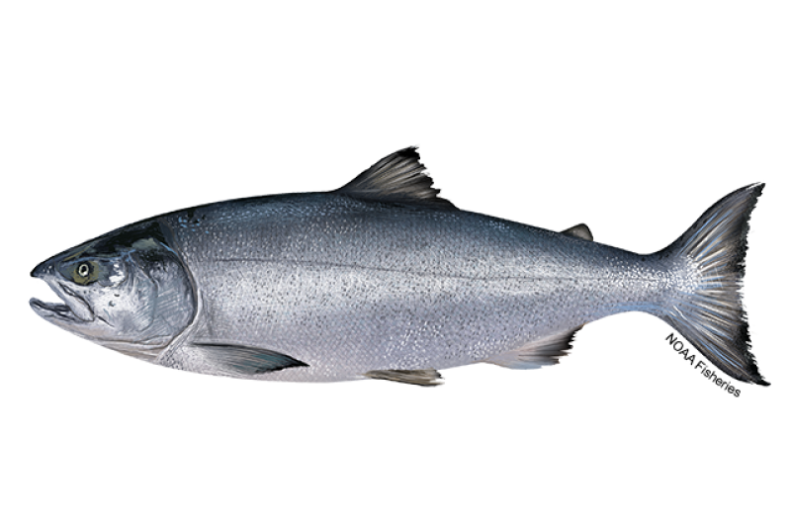
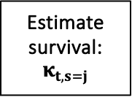
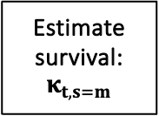
1.N_{t,s=e}: Eggs
Fall Chum Integrated Population Model Structure
Estimate survival: $κ_{t,s=j}$
2. N_{t+1,s=j}: Abundance after first summer at sea (August/Sept)
Juvenile Index from Northern Bering Sea surveys
(Data: NOAA/ADFG, Modeled Index: Cunningham et al.)
Fish migrate to the E. Aleutians & Gulf of Alaska (GOA) for their first winter, and subsequent maturation.
5. N_{t+a+1,s=s,a}: Spawning abundance
Data: ADFG, Fleischman & Borba 2009
Estimate survival: $κ_{t, s=m}$
4. N_{t+a+1,s=h,a}: Harvest abundance
Data: ADFG, Fleischman & Borba 2009
3. N_{t+a+1,s=m,a}: Returning fish abundance
Data: ADFG, Fleischman & Borba 2009
Notes:
Figure 1: Conceptual model describing the main steps in the fall Chum integrated population model. Blue stars indicate that fish move to the E. Aleutians and GOA for their first winter and subsequent maturation. Each numbered step represents a population stages that is tracked in the IPM. Stages in orange represent stages where the model estimations are included in the likelihood. After the spawning abundance stage, the model starts over again at stage 1, the egg stage. Note that location of each stage does not reflect the location of individuals at any particular stage. The map on the right-hand side of the figure includes Alaska, USA, and western Canada. The mask is highlighting the Yukon River watershed and associated tributaries. The mainstem of the Yukon River is the most prominent dark blue line and the green dots represent escapement project locations that were used as data in the Fall chum salmon run reconstruction.

Slide 13
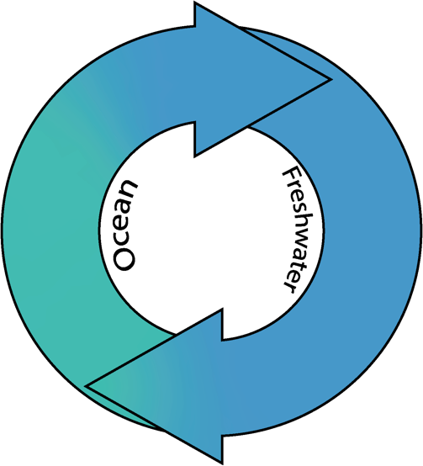
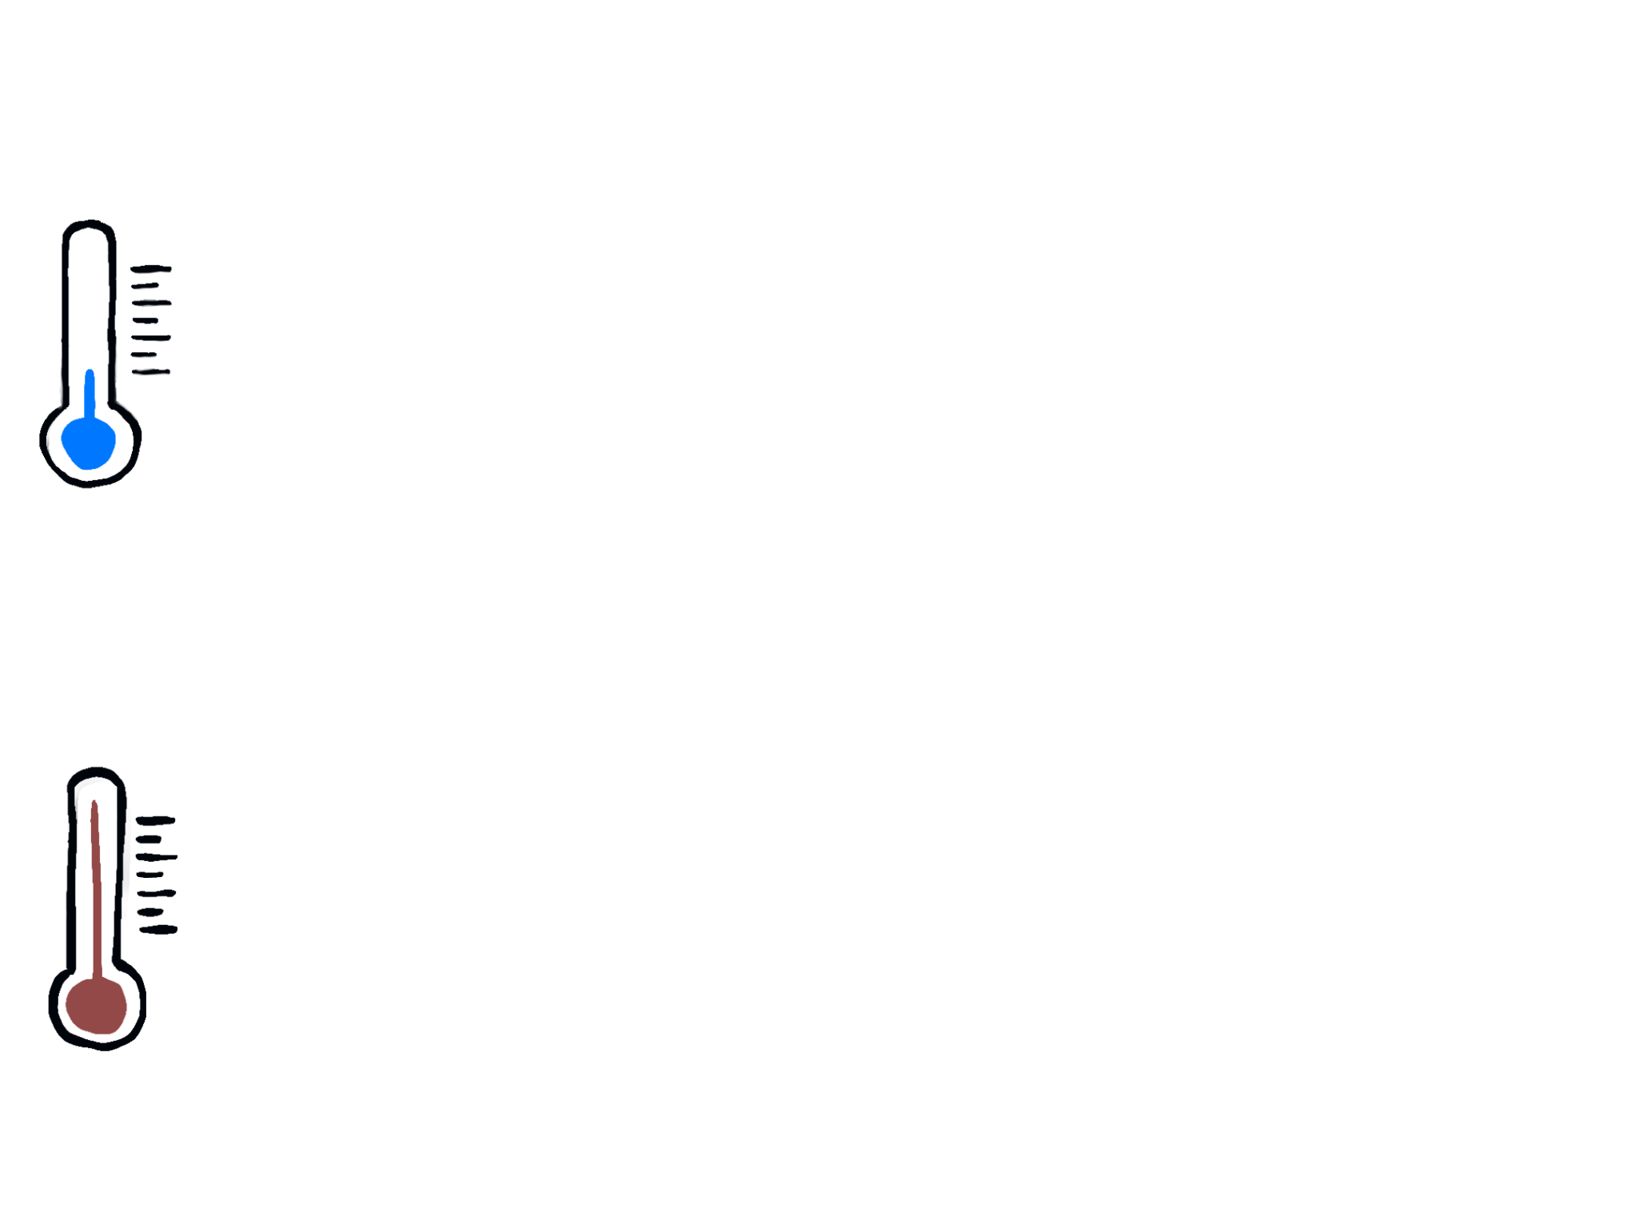
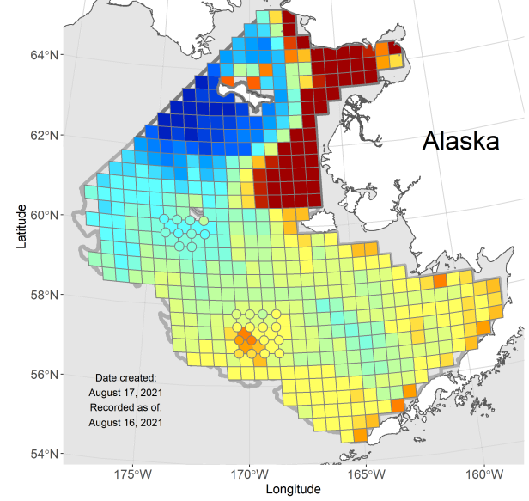
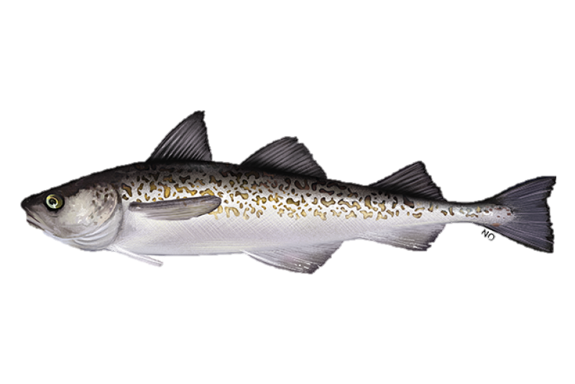
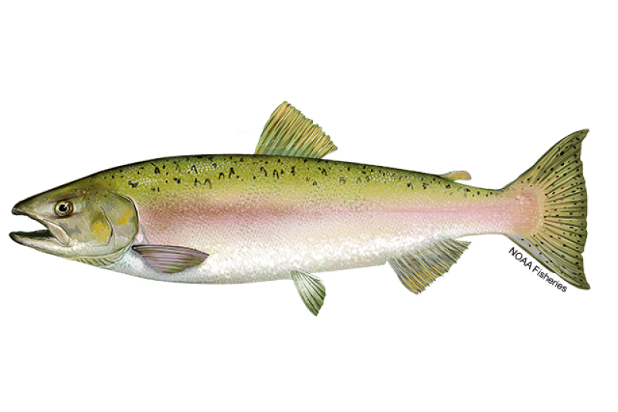
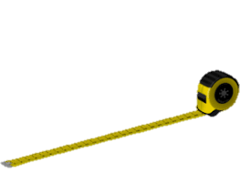
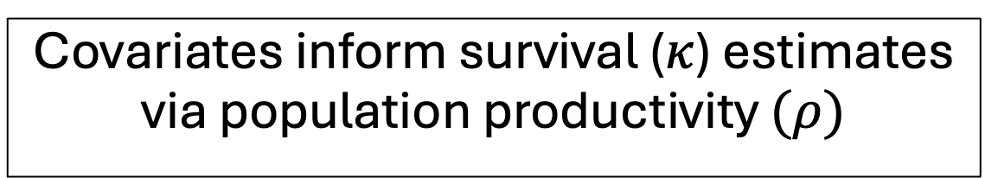
Covariates inform survival ($κ$) estimates via population productivity $(ρ)$
1.Yukon river mainstem flow rate (Pilot Station)
- Data: USGS
8. Aleutian Cumulative Degree Days during 1st winter
(Data: AKFIN, NOAA)
2. N Bering Sea Summer Cumulative Degree Days
- Data: AKFIN, NOAA
7. “Juvenile fullness index”
(Estimated from NBS surveys, data: NOAA & ADFG).
Marine Survival
Juvenile Survival
3. Pollock Recruitment Index
- Ianelli et al 2024
6. Pink hatchery salmon abundance
5. Chum hatchery salmon abundance
(Data: NPAFC)
4. Mean Spawner Size
- ADFG
5. Gelatinous zooplankton may provide lower quality prey (Cook & Sturdevant 2013).
Notes:
Figure 2: Covariates used to estimate chum salmon population productivity for two life stages. Data sources listed below the covariate and more covariate details are listed in Table 2.

Slide 14
Notes:
Figure 3: Time series of indices used in the model likelihood inputs and model fits.
Points represent juvenile (a) and returning fish (b) indices used in the model likelihood while the lines represent the mean from estimated posterior distributions. Colored bands represent 95% credible intervals. The x axis represents the brood year, or the year when fish are in the egg stage. The NBS survey used to estimate the juvenile index did not occur in 2020 due to the global pandemic, so there is no juvenile index for brood year 2019.

Slide 15
Notes:
Figure 4: Mean estimates of covariate coefficients. Colors represent the life-stage where survival is estimated, informed by the respective covariate. Points represent mean estimates, thick lines represent 89% credible intervals and thin lines represent 95% credible intervals.

Slide 16
Supplementary Figures

Slide 17
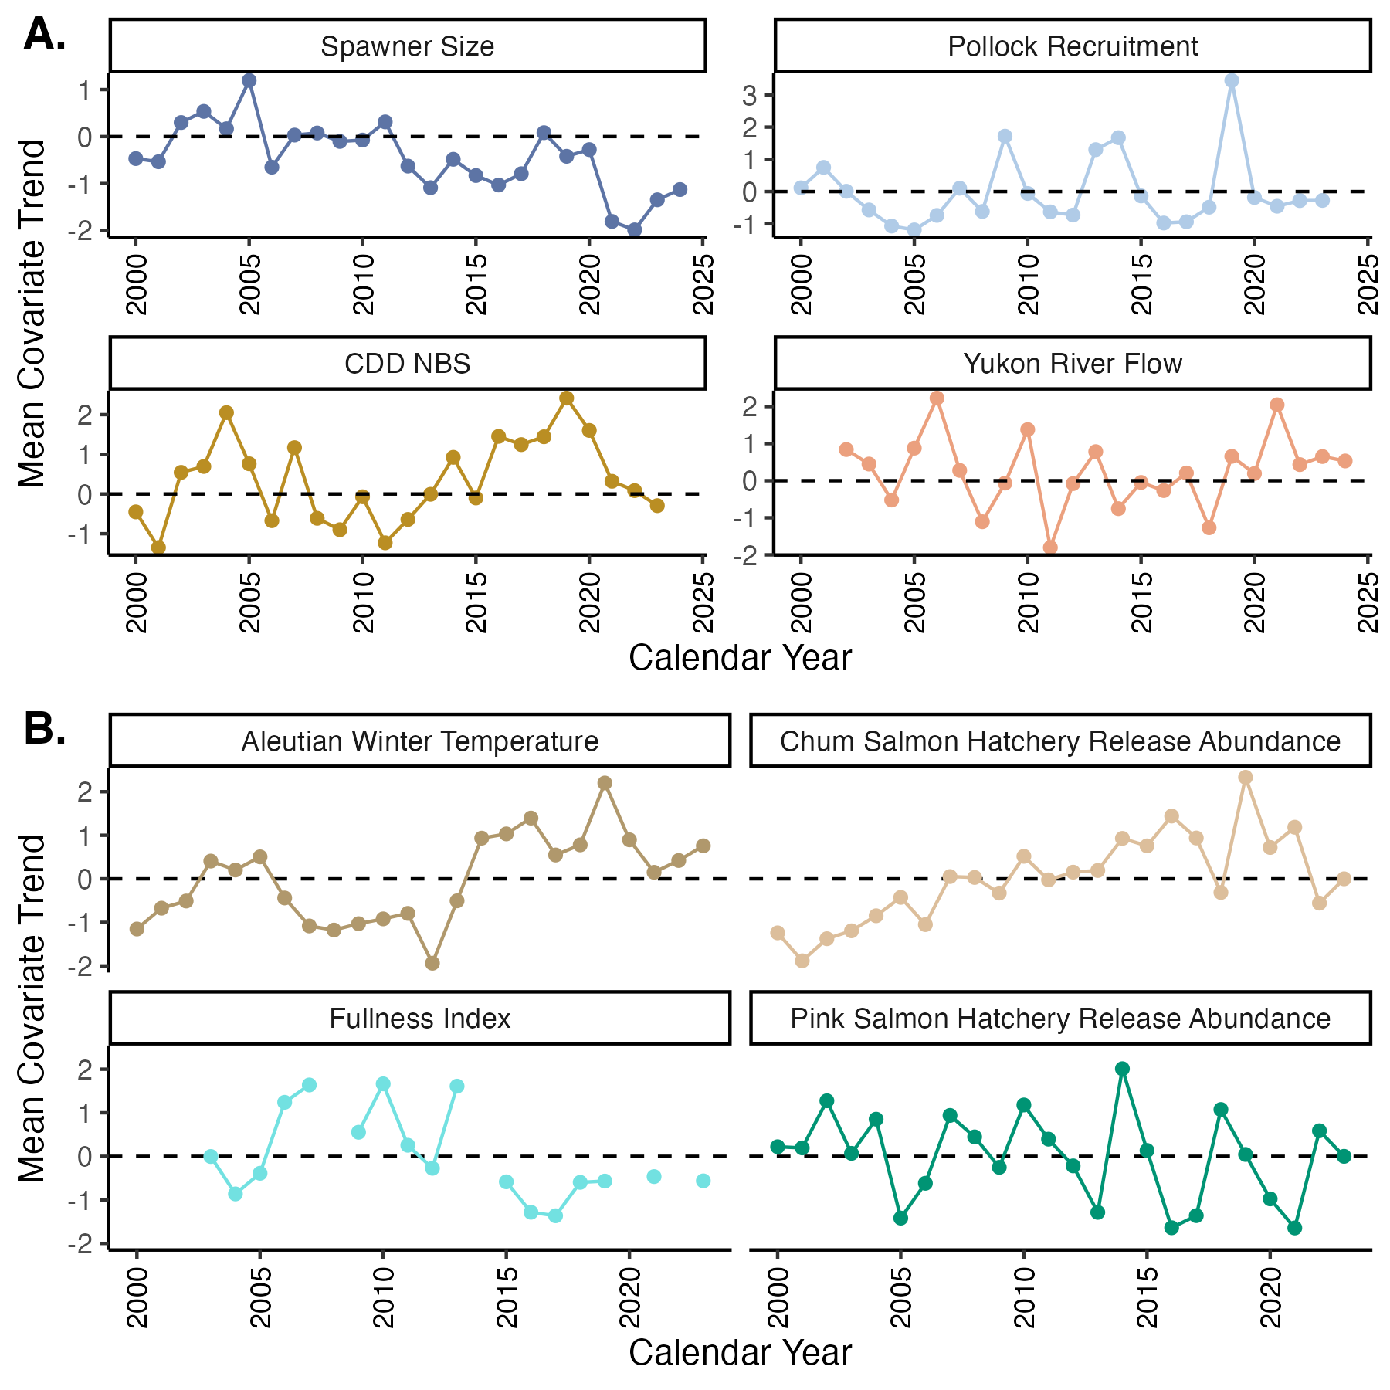
Notes:
Caption: Mean-scaled covariate trends used in the IPM for the a) juvenile (egg to first summer at sea) and b) marine (first summer at sea to end of first winter at sea) stages.

Slide 18
Notes:
Figure S1 – Trace plots used to identify model convergence for each for parameters. Four chains were run per model, dark shading represents burn-in iterations.

Slide 19
Notes:
Figure S2:
Results from covariate sensitivity testing. We calculated percent relative difference in covariate coefficients from the full model compared to a reduced model where one covariate removed at a time (covariate removed identified on x axis).

